Slide 1
REMOTEBASE HACKFEST ‘21
KDSP Patient Management Information System
Programmers

Slide 2
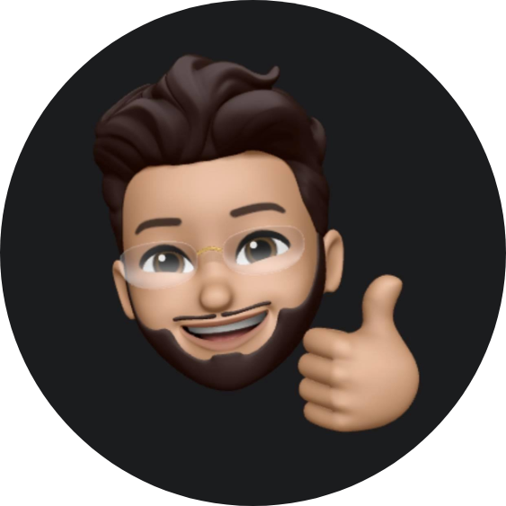
Team Members
Sarfaraz Ahmed
Solution Architect & Developer
Ghilman Khan
Developer

Slide 3
Problem Statement
“KDSP # Create an app that KDSP can use to record and maintain database of Individuals with Down Syndrome.”

Slide 4
Solution
We have developed windows based desktop application. SQL Server as backend database.

Slide 5
Team Strategy
Implemented whole solution, backend, frontend and data layer myself.

Slide 6
Design and Architecture
Database covers almost all scenarios. Frontend screens are limited. Used Entity Framework as Data Access Layer.

Slide 7
Frontend/Backend
Windows Forms application as Frontend.
Entity Framework as Data Access Layer
SQL Server as Backend.

Slide 8
Code Demo
public static List<AppointmentDTO> GetAppointmentsByPatient(int PatientId)
{
using (KDSPEntities _entity = new KDSPEntities())
{
var appointments = (from pa in _entity.PatientAppointments
join p in _entity.Patients on pa.PatientId equals p.Id
join t in _entity.Therapists on pa.TherapistId equals t.Id
join ts in _entity.TherapistSchedules on pa.TherapistScheduleId equals ts.Id
where p.Id == PatientId
select new AppointmentDTO()
{
TherapistScheduleId = pa.TherapistScheduleId, PatientFullName=p.PatientFullName, TherapistFullName=t.TherapistFullName,
PatientId = pa.PatientId, TherapistId=pa.TherapistId, AppointmentDate = pa.AppointmentDate, StartTime = ts.StartTime, EndTime=ts.EndTime,
Status = pa.Status, PaymentStatus = pa.PaymentStatus, SessionNumber = pa.SessionNumber, AppId = pa.Id, Therapy = p.TherapyDept
}).ToList<AppointmentDTO>();
return appointments;
}
}

Slide 9
Thank you
Any Questions?

